Slide 1

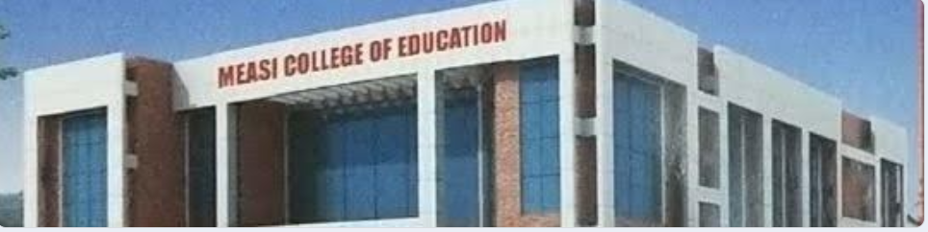
MEASI COLLEGE OF EDUCATION

Slide 2


Slide 3
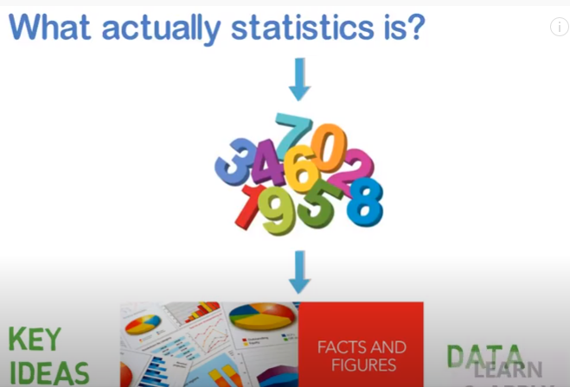

Slide 4


Slide 5
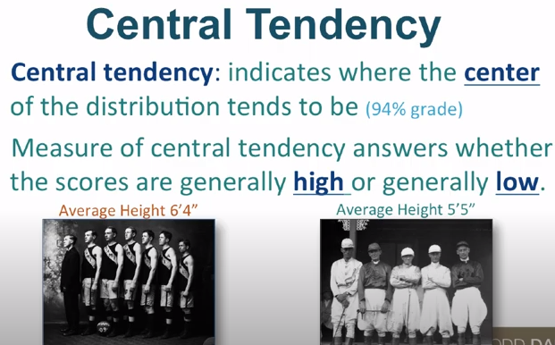

Slide 6

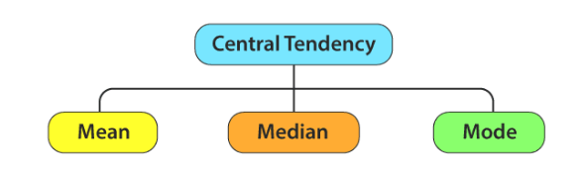

Slide 7

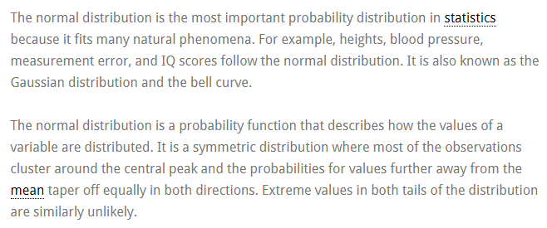
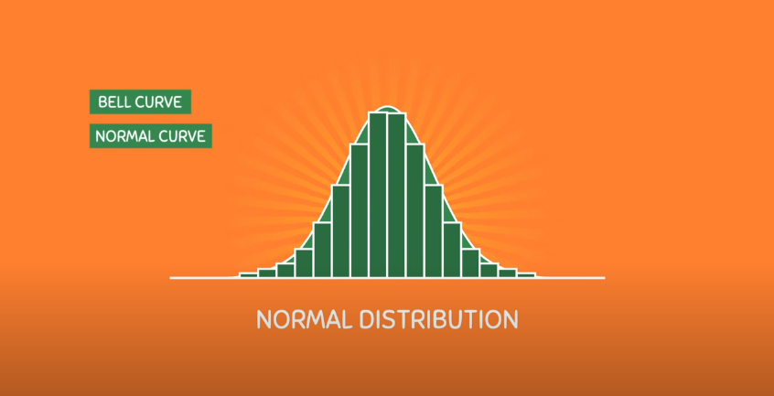

Slide 8
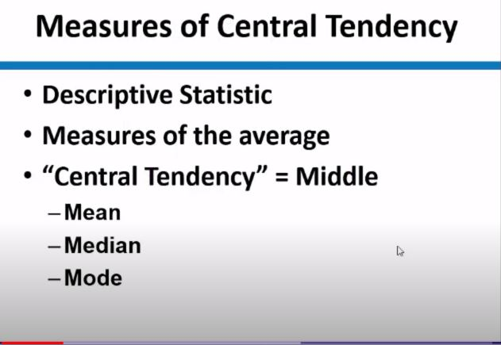

Slide 9

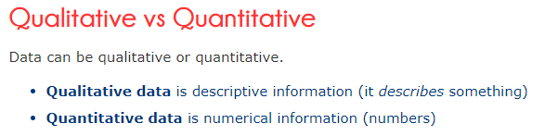

Slide 10

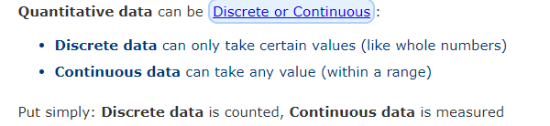
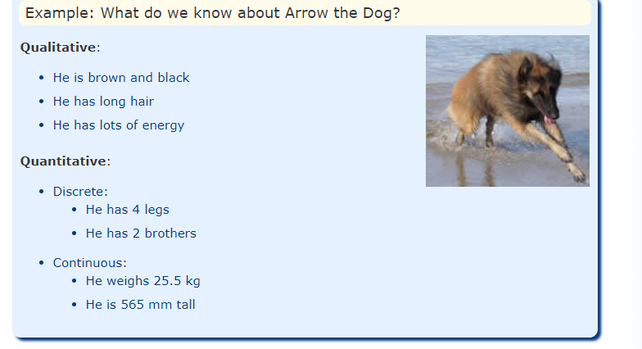

Slide 11


Slide 12

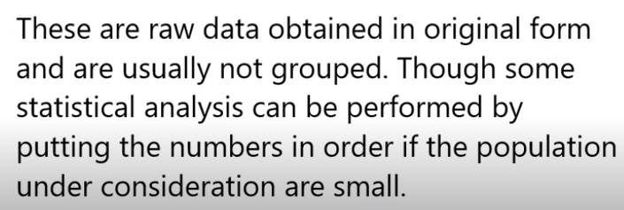



Slide 13
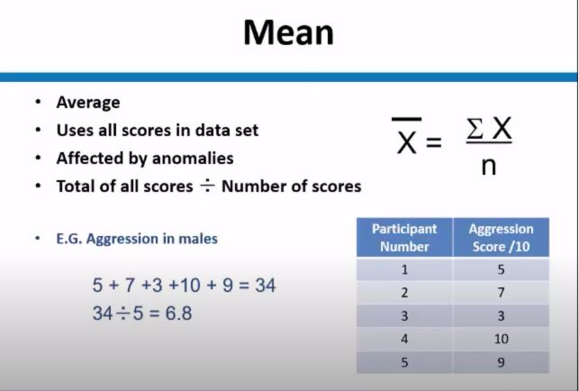



Slide 14
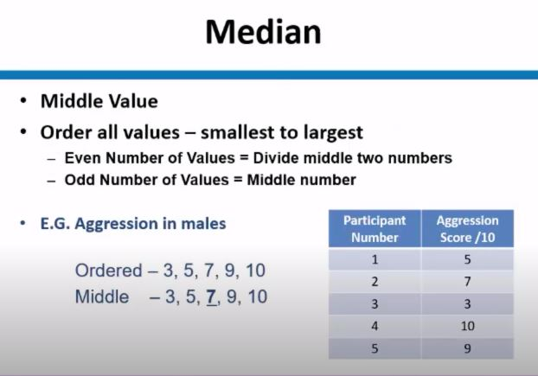


Slide 15
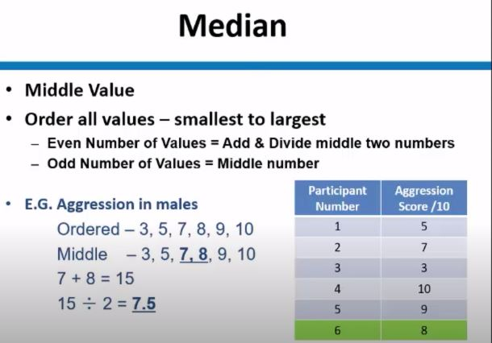

Slide 16
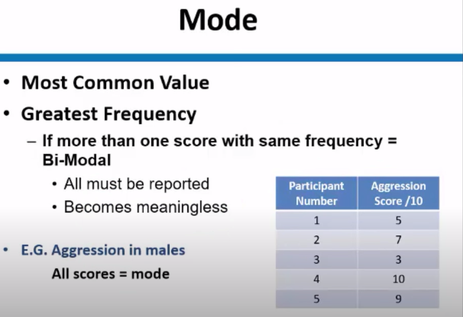

Slide 17
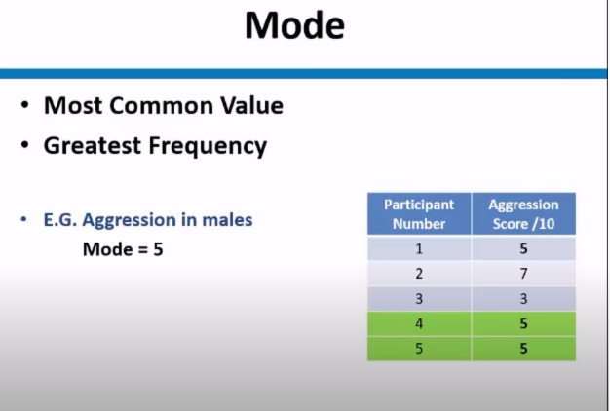

Slide 18

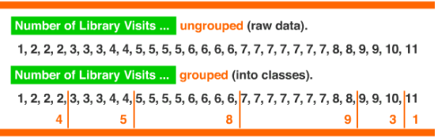

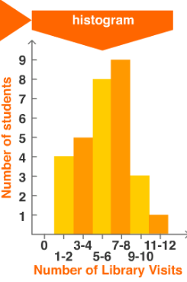
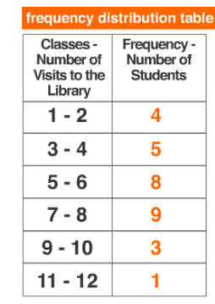

Slide 19

$$\overline{x}=A+\frac{\sum{fd}}{\sum{f}}×C⋅I$$
 | A= Assumed Mean
 | ∑f = Total of frequency
 | C.I =Range of Class interval
 | d= Derivations of midpoints from assumed mean

Slide 20
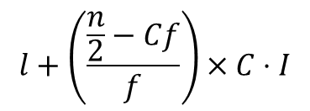
Formula:
$$l+\left(\frac{\frac{n}{2}−Cf}{f}\right)×C⋅I$$
Median=
where
l = lower limit of the median class
f = frequency of the median
n = total number of items
Cf = cumulative frequency
C.I = class interval

Slide 21

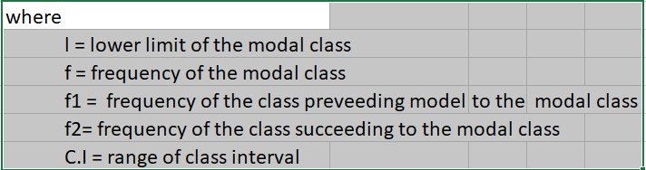
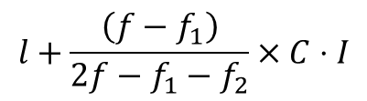
Formula
$$l+\frac{\left(f−f_{1}\right)}{2f−f_{1}−f_{2}}×C⋅I$$
Mode =

Slide 22

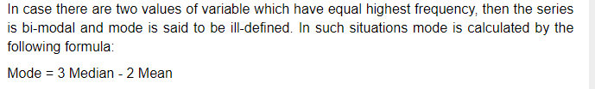
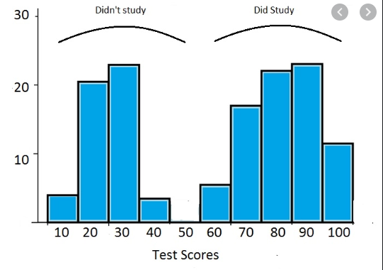

Slide 23
INTERPRETATION:
From the values of Mean, Median and Mode, we confirm that,
IF Mean = Median = Mode then most of the students in the class secured Average Marks
IF Mean < Median < Mode then most of the students in the class secured High Marks
IF Mean > Median > Mode then most of the students in the class secured low Marks

Slide 24
MARK LIST
S.NO | NAME | MATH MARKS
1 | V.DINESH | 92
2 | H.PRADEEP | 91
3 | E.YOGESHWARAN | 90
4 | M.SARAN | 86
5 | S.SUHIL | 82
6 | M.HARISH | 76
7 | T.MOHAMMED HAFIZ | 72
8 | R.BHUVANESH | 66
9 | S.RAHUL | 65
10 | G.TAMILARASAN | 64
11 | D.KANISHKA | 62
12 | V.MONIKA | 60
13 | S.ROHAN | 60
14 | R.RAHUL | 58
15 | G.DINESH KUMAR | 56
16 | D.DILLI BABU | 52
17 | M.SAKTHI | 50
18 | S.NITHISH | 48
19 | V.VIGNESH | 46
20 | A.THAMEEM | 42
21 | S.RISHWAN | 40
22 | S.BHARATH RAJ | 38
23 | M.VISHAL | 37
24 | S.PARASURAMAN | 36
25 | M.BALAJI | 32

Slide 25


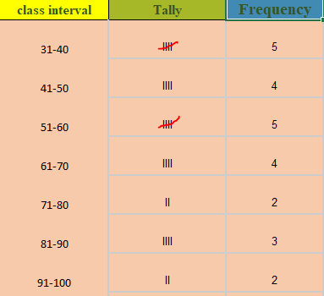
Find the mean, median and mode of the following data:
92 | 91 | 90 | 86 | 82 | 76 | 72 | 66 | 65 | 64 | 62 | 60 | 60 | 58 | 56
52 | 50 | 48 | 46 | 42 | 40 | 38 | 37 | 36 | 32

Slide 26
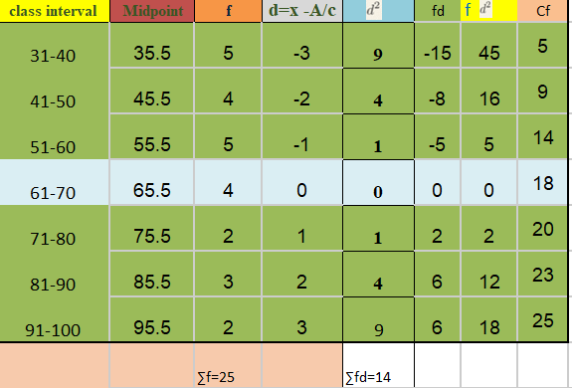

Table:
∑f d = -14

Slide 27
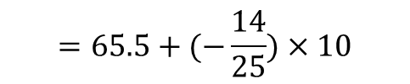
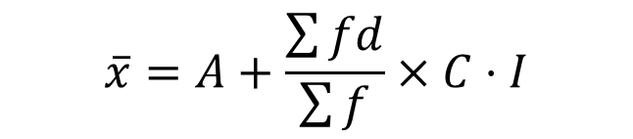



ARITHMETIC MEAN:
$$\overline{x}=A+\frac{\sum{fd}}{\sum{f}}×C⋅I$$
where,
A = 65.5
∑fd = -14
∑f = 25
C.I = 10
$$=65.5+(−\frac{14}{25})×10$$
$=65.5$ - 5.6
$$\overline{x}=59.9$$
Mean $=59.9$

Slide 28
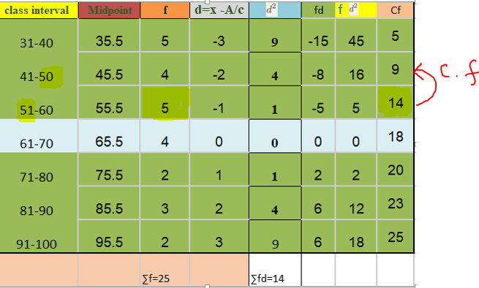
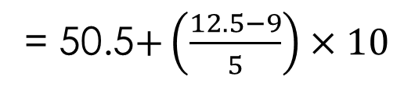
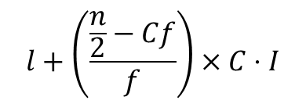
Median:
$$l+\left(\frac{\frac{n}{2}−Cf}{f}\right)×C⋅I$$
Median =
Where,
N/2 = 12.5
l = 50.5
C.f = 9
f = 5
= 50.5$+\left(\frac{12.5−9}{5}\right)×10$
= 50.5 + 7
= 57.5
Median = 57.5
∑fd = -14

Slide 29
Mode:
Mode = 3 median - 2 mean
Where, Mean = 59.5
Median = 57.5
= 3 (57.5) - 2 (59.5)
= 172.5 - 119.8
= 52.7
Mode = 52.7

Slide 30
INTERPRETATION:
Mean = 59.9
Median = 57.5
Mode = 52.7
From the above values,We have
Mean > Median > Mode
59.9 > 57.5 > 52.7
From the above interpretation we see that most of the students secure low marks

Slide 31
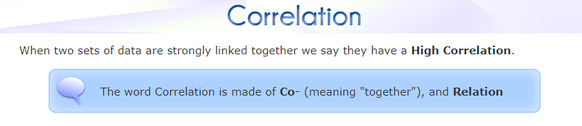

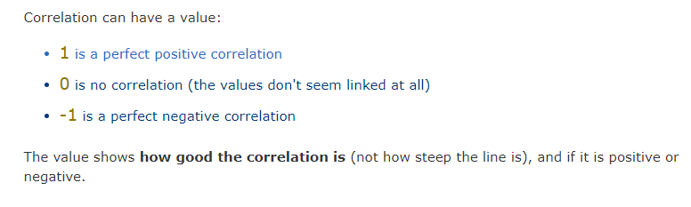

Slide 32


Slide 33


Slide 34


Slide 35


Slide 36
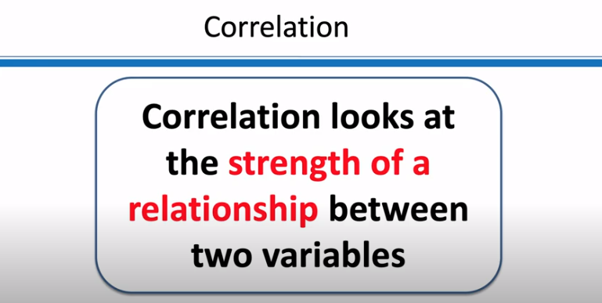

Slide 37
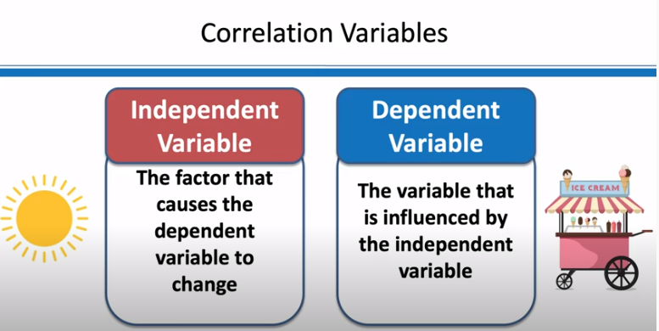

Slide 38
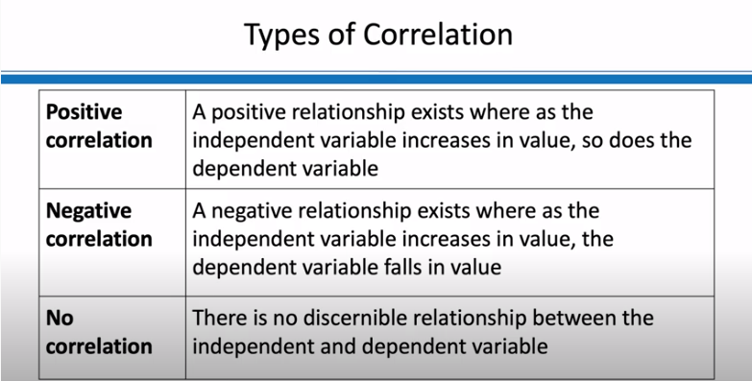

Slide 39

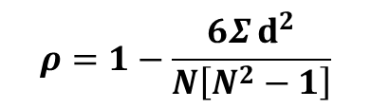
The Spearman's rank-order correlation is the nonparametric version of the Pearson product-moment correlation. Spearman's correlation coefficient, (ρ, also signified by r_{s}) measures the strength and direction of association between two ranked variables.
$$ρ=1−\frac{6Σⅆ^{2}}{N\left[N^{2}−1\right]}$$
d = difference between paired items
N = Number of items

Slide 40
What values can the Spearman correlation coefficient, ρ,take?
Your data must be ordinal, interval or ratio. Spearman’s returns a value from -1 to 1,
where:
+1= a perfect positive correlation between ranks
-1 = a perfect negative correlation between ranks
0 = no correlation between ranks
Interpretation of ρ
value of ρ | Interpretation
0.00 to 0.20 | Independent or negligible relationship
0.20 to 0.40 | Low correlation
0.40 to 0.70 | High correlation
0.70 to 1.00 | very high correlation

Slide 41
To calculate a Spearman rank-order correlation on data without any ties we will use the following data
 | MARK LIST
S.NO | NAME | MATH MARKS | SCIENCE MARKS
1 | V.DINESH | 92 | 80
2 | H.PRADEEP | 91 | 88
3 | E.YOGESHWARAN | 90 | 76
4 | M.SARAN | 86 | 65
5 | S.SUHIL | 82 | 79
6 | M.HARISH | 76 | 80
7 | T.MOHAMMED HAFIZ | 72 | 82
8 | R.BHUVANESH | 66 | 58
9 | S.RAHUL | 65 | 46
10 | G.TAMILARASAN | 64 | 52
11 | D.KANISHKA | 62 | 75
12 | V.MONIKA | 60 | 42
13 | S.ROHAN | 60 | 54
14 | R.RAHUL | 58 | 62
15 | G.DINESH KUMAR | 56 | 40
16 | D.DILLI BABU | 52 | 45
17 | M.SAKTHI | 50 | 52
18 | S.NITHISH | 48 | 54
19 | V.VIGNESH | 46 | 60
20 | A.THAMEEM | 42 | 37
21 | S.RISHWAN | 40 | 35
22 | S.BHARATH RAJ | 38 | 32
23 | M.VISHAL | 37 | 50
24 | S.PARASURAMAN | 36 | 47
25 | M.BALAJI | 32 | 45

Slide 42


 |  | RANK CORRELATION
S.NO | NAME | MATH MARKS | SCIENCE MARKS | R1 | R2 | d = R1-R2
1 | V.DINESH | 92 | 80 | 1 | 3.5 | -2.5 | 6.25
2 | H.PRADEEP | 91 | 88 | 2 | 1 | 1 | 1
3 | E.YOGESHWARAN | 90 | 76 | 3 | 6 | 3 | 9
4 | M.SARAN | 86 | 65 | 4 | 8 | -4 | 16
5 | S.SUHIL | 82 | 79 | 5 | 5 | 0 | 0
6 | M.HARISH | 76 | 80 | 6 | 3.5 | 2.5 | 6.25
7 | T.MOHAMMED HAFIZ | 72 | 82 | 7 | 2 | 5 | 25
8 | R.BHUVANESH | 66 | 58 | 8 | 11 | -3 | 9
9 | S.RAHUL | 65 | 46 | 9 | 18 | -9 | 81
10 | G.TAMILARASAN | 64 | 52 | 10 | 14.5 | -4.5 | 20.25
11 | D.KANISHKA | 62 | 75 | 11 | 7 | 4 | 16
12 | V.MONIKA | 60 | 42 | 12.5 | 21 | -8.5 | 72.25
13 | S.ROHAN | 60 | 54 | 12.5 | 12.5 | 0 | 0
14 | R.RAHUL | 58 | 62 | 14 | 9 | 5 | 25
15 | G.DINESH KUMAR | 56 | 40 | 15 | 22 | -7 | 49
16 | D.DILLI BABU | 52 | 45 | 16 | 19.5 | -3.5 | 12.25
17 | M.SAKTHI | 50 | 52 | 17 | 14.5 | 2.5 | 6.25
18 | S.NITHISH | 48 | 54 | 18 | 12.5 | 5.5 | 30.25
19 | V.VIGNESH | 46 | 60 | 19 | 10 | 9 | 81
20 | A.THAMEEM | 42 | 37 | 20 | 23 | -3 | 9
21 | S.RISHWAN | 40 | 35 | 21 | 24 | -3 | 9
22 | S.BHARATH RAJ | 38 | 32 | 22 | 25 | 3 | 9
23 | M.VISHAL | 37 | 50 | 23 | 16 | 7 | 49
24 | S.PARASURAMAN | 36 | 47 | 24 | 17 | 7 | 49
25 | M.BALAJI | 32 | 45 | 25 | 19.5 | 5.5 | 30.25
 |  |  |  |  |  |  | 621 621
 |  | RANK CORRELATION
S.NO | NAME | MATH MARKS | SCIENCE MARKS | R1 | R2 | d = R1-R2
1 | V.DINESH | 92 | 80 | 1 | 3.5 | -2.5 | 6.25
2 | H.PRADEEP | 91 | 88 | 2 | 1 | 1 | 1
3 | E.YOGESHWARAN | 90 | 76 | 3 | 6 | 3 | 9
4 | M.SARAN | 86 | 65 | 4 | 8 | -4 | 16
5 | S.SUHIL | 82 | 79 | 5 | 5 | 0 | 0
6 | M.HARISH | 76 | 80 | 6 | 3.5 | 2.5 | 6.25
7 | T.MOHAMMED HAFIZ | 72 | 82 | 7 | 2 | 5 | 25
8 | R.BHUVANESH | 66 | 58 | 8 | 11 | -3 | 9
9 | S.RAHUL | 65 | 46 | 9 | 18 | -9 | 81
10 | G.TAMILARASAN | 64 | 52 | 10 | 14.5 | -4.5 | 20.25
11 | D.KANISHKA | 62 | 75 | 11 | 7 | 4 | 16
12 | V.MONIKA | 60 | 42 | 12.5 | 21 | -8.5 | 72.25
13 | S.ROHAN | 60 | 54 | 12.5 | 12.5 | 0 | 0
14 | R.RAHUL | 58 | 62 | 14 | 9 | 5 | 25
15 | G.DINESH KUMAR | 56 | 40 | 15 | 22 | -7 | 49
16 | D.DILLI BABU | 52 | 45 | 16 | 19.5 | -3.5 | 12.25
17 | M.SAKTHI | 50 | 52 | 17 | 14.5 | 2.5 | 6.25
18 | S.NITHISH | 48 | 54 | 18 | 12.5 | 5.5 | 30.25
19 | V.VIGNESH | 46 | 60 | 19 | 10 | 9 | 81
20 | A.THAMEEM | 42 | 37 | 20 | 23 | -3 | 9
21 | S.RISHWAN | 40 | 35 | 21 | 24 | -3 | 9
22 | S.BHARATH RAJ | 38 | 32 | 22 | 25 | 3 | 9
23 | M.VISHAL | 37 | 50 | 23 | 16 | 7 | 49
24 | S.PARASURAMAN | 36 | 47 | 24 | 17 | 7 | 49
25 | M.BALAJI | 32 | 45 | 25 | 19.5 | 5.5 | 30.25
 |  |  |  |  |  |  | 621

Slide 43

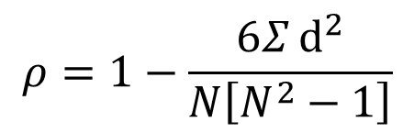

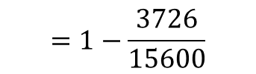
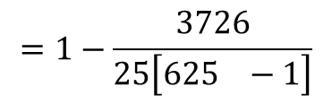
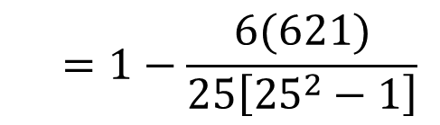
$$ρ=1−\frac{6Σⅆ^{2}}{N\left[N^{2}−1\right]}$$
$$=1−\frac{6(621)}{25\left[{25}^{2}−1\right]}$$
Where,
N = 25
∑d2 =621
$$=1−\frac{3726}{25\left[{625}^{}−1\right]}$$
$$=1−\frac{3726}{15600}$$
$=1−0.2388$
$$ρ=0.76$$
Thus from the interpretation of ρ, very high correlation exists between Mathematics and Science.
That is ,those who secured good marks in Mathematics also secured good marks in science

Slide 44
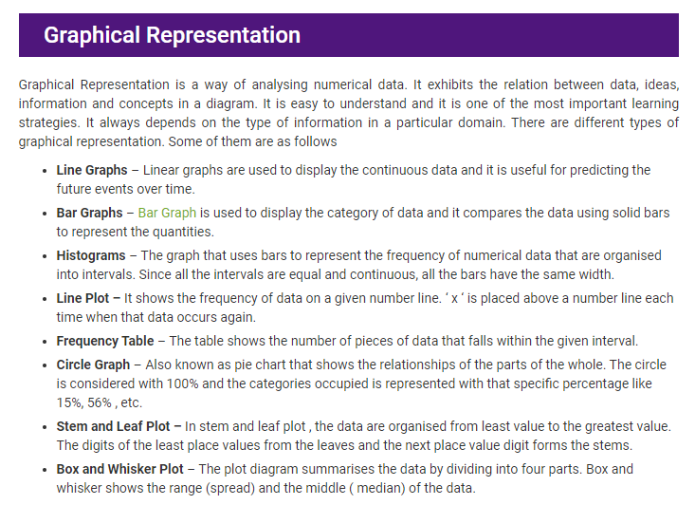

Slide 45

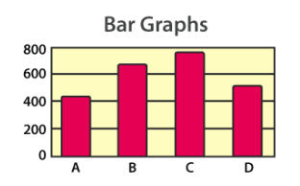
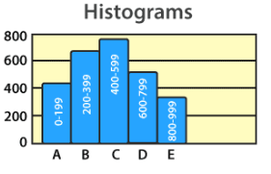
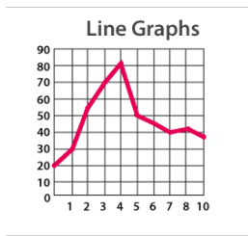
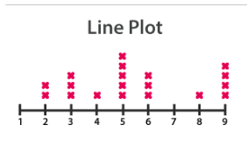
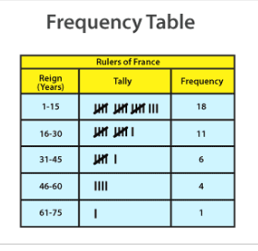
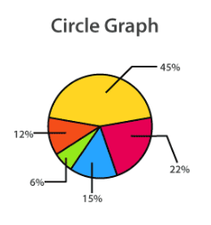
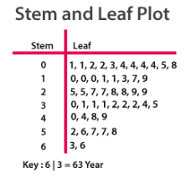
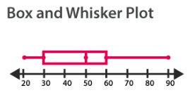

Slide 46


Slide 47


